Slide 1
This presentation is designed as an aid for teachers (or students) who wish to give more information about being a School of Sanctuary to colleagues and students.
We encourage presenters to be familiar with the more detailed explanation of the Learn, Action, Share principles that is available on our website.
It is also worth assessing and mentioning/discussing what “sanctuary activities” are already happening in the school
Please do not edit this presentation but feel free to copy it and edit your copy for use!

Slide 3
About Schools of Sanctuary Ireland
A national organisation that supports schools in Ireland to promote a culture of understanding, welcome, safety and inclusion for those seeking sanctuary in their communities (especially refugees)
Schools become a Member School of Sanctuary first and work towards achieving the Champion School of Sanctuary award, if they so wish.
SoSI began in 2019 and, as of Sept 2023, now has 19 Champion Schools and 39 Member Schools throughout Ireland.

Slide 4
What does Sanctuary look like in schools?
A visible demonstration and prioritisation of welcome and inclusion for all students and their families
A proud celebration of diverse cultures, lifestyles and ethnicities
A commitment to share learning in how to better support vulnerable students, to taking action against prejudice and racism and to being proud to stand in solidarity with vulnerable minorities

Slide 5
No deadlines; schools start their journey whenever they wish
SoS is not a prescribed programme
Schools curate, plan and direct their own journey, responding to their own student and staff body needs
No membership fee (requested donation for monitoring visits)

Slide 6
The Sanctuary Principles

Slide 7
Intercultural
Skills
Learn
Migration,
forced migration
Racism & Anti-Racism
How to help,
what is needed

Slide 8
Learn the facts about refugees, migrants and people seeking asylum in Ireland and in the world. Incorporate the topics of migration and forced displacement into the application of the curriculum in as many ways as possible.
Learn about welcoming newcomer students and their families in an interculturally sensitive way and how they can be supported to integrate.

Slide 9
Learn about racism/anti-racism
Learn about the barriers/challenges that face many ethnic minorities, incl. Irish Travellers.
Explore stories of displacement- in books, media etc- or have a school visit from a Sanctuary Ambassador (someone with lived experience of seeking sanctuary in Ireland)

Slide 10
Events, celebrations, campaigns
Action
Language Supports
Representative,
inclusive
spaces
Peer and wrap-around supports

Slide 11
Facilitate and celebrate the multilingualism and multiculturalism of the student body and their families
Ensure your school is visually diverse and representative and that school policies and plans reflect the sanctuary ethos
Ensure student and parent committees are representative and inclusive; hear every voice and point of view

Slide 12
Support vulnerable students in their participation in extra-curricular in-school and after-school activities
Participate in SoSI events and other national schools campaigns, e.g. Wear Red Day
Where possible, partner with local organisations or charities who help vulnerable families, e.g. shoebox Christmas appeal.

Slide 13
Participate
in SoSI
events
Collaborating
with other
schools
SoSI is visible in the school building
School Website amd Comms

Slide 14
Display info about SoS prominently on the school website and in the school building
Share the message of sanctuary with local or linked schools and in your school communications
Share info about SoSI online or in-person events where possible
Collaborate with other schools when possible, with teachers and students exchanging ideas about the sanctuary journey

Slide 15
How do we build evidence of our journey?

Slide 16
The Sanctuary Portfolio
A showcase of the evidence of the school’s Sanctuary journey
Demonstrates some of the Learning, the Actions in the school and how the school Shared its practice
Notes:
Briefly mention what happens when school wishes to go for the Champion award- will be addressed at the end.

Slide 17
Champion School Portfolios
(Click to view)
Ardscoil na Mara, Tramore, Co. Waterford (Champion award 2023)
Desmond College, Newcastle West, Co. Limerick (Champion 2022)
Bunscoil McAuley Rice, Callan, Co. Kilkenny (Champion 2022)
St Mary’s National School, Limerick (Champion 2021)

Slide 18
Getting Started
Planning Phase-
What is already happening in your classrooms and school environment? What can we add? How can this fit into school plans and initiatives, e.g. wellbeing?
How do we involve students? Sanctuary committee, sanctuary club, diversity committee etc.

Slide 20
A DEEPER LOOK AT ‘LEARN ACTION SHARE’
SOSI CHARTER & PLEDGE FORM
CLASSROOM RESOURCES AND TEACHING AIDS ON THE WEBSITE

Slide 21
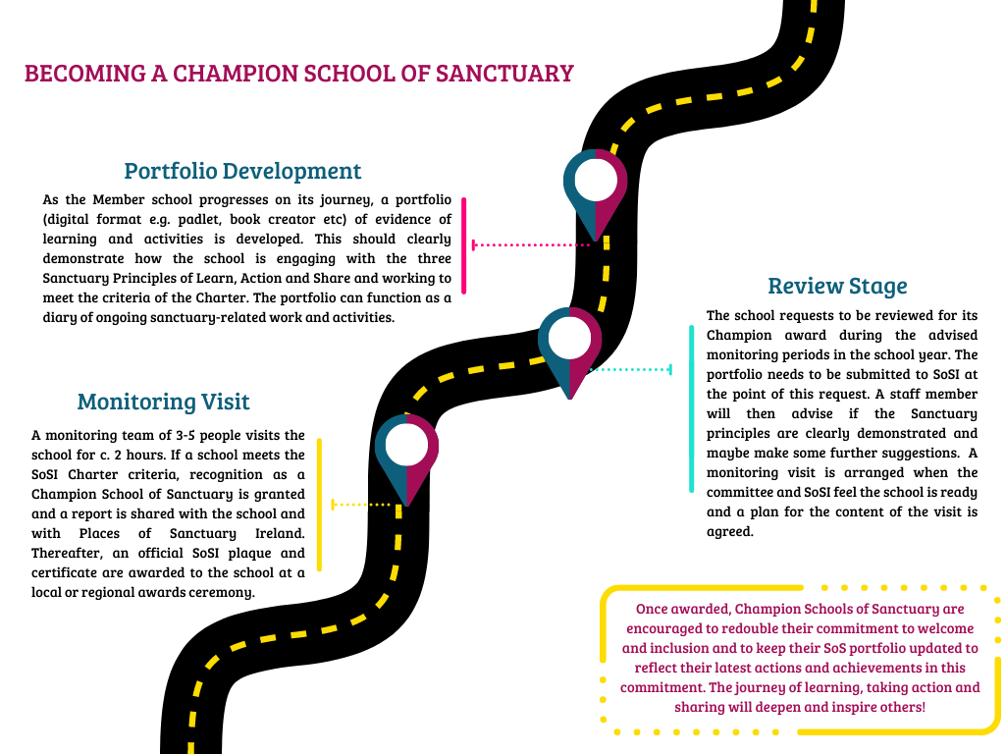

Slide 22
Benefits for Schools
Provides schools with a valuable structure for growth in their own approach to inclusion and equality.
Schools forge links with a national Sanctuary family of schools throughout Ireland and also join in a network of the many third level institutions, libraries and other community organisations in the Sanctuary movement.
The Sanctuary journey equips students of all ages to be a strong, confident voice for inclusion, diversity and equality in 21st century Ireland

Slide 24
https://schools-ireland.cityofsanctuary.org/
SchoolsofSanctuaryIreland SofSIreland
sos_ireland schools-of-sanctuary-ireland

